Slide 1
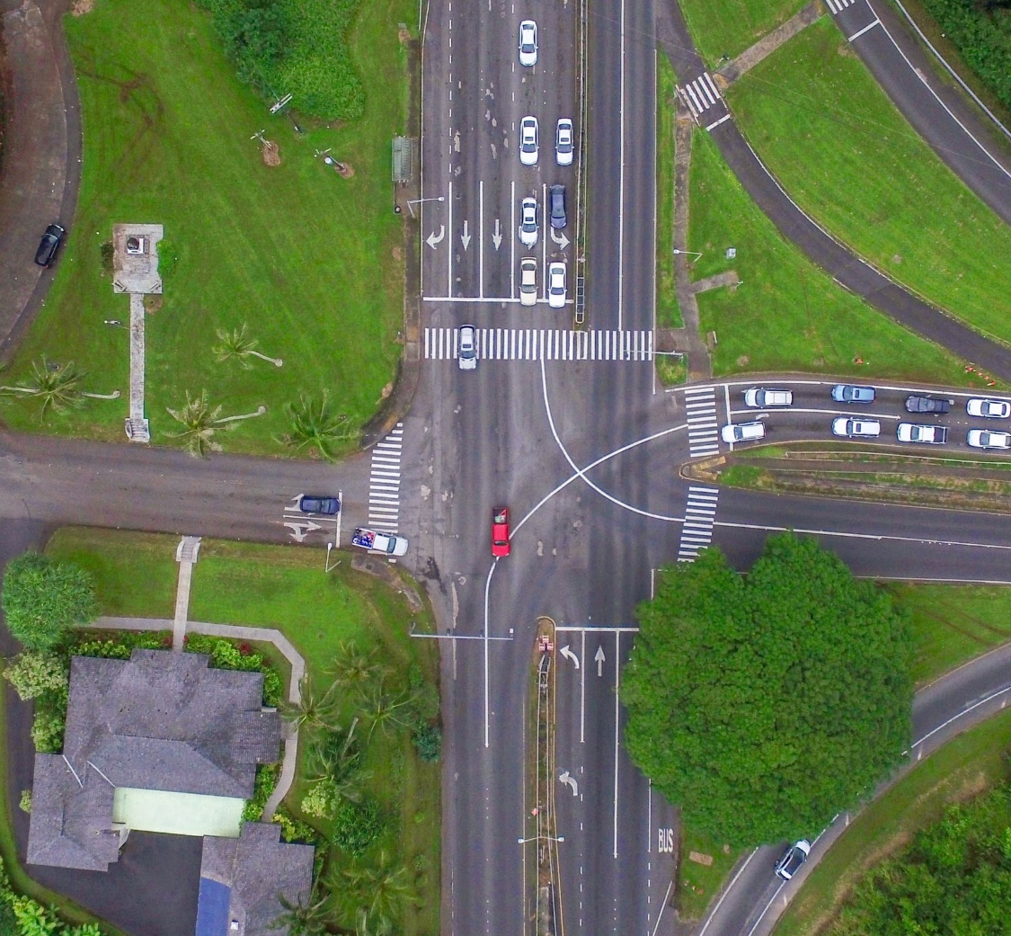
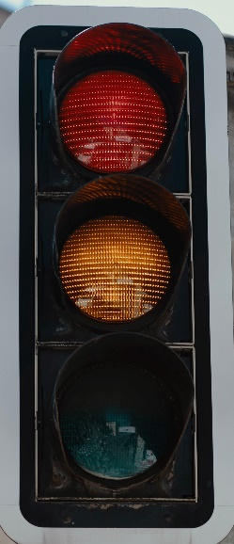
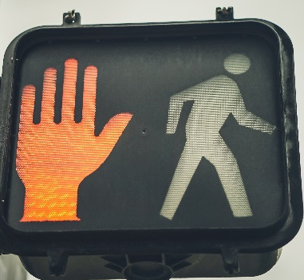
North-South GREEN
Pedestrian Crossing DON'T WALK
East-West RED

Slide 2
North-South YELLOW
Pedestrian Crossing DON'T WALK
East-West RED

Slide 3
North-South RED
Pedestrian Crossing DON'T WALK
East-West GREEN

Slide 4
North-South RED
Pedestrian Crossing DON'T WALK
East-West YELLOW

Slide 5
North-South RED
Pedestrian Crossing WALK
East-West RED

Slide 6
Green
Yellow
Red

